Slide 1
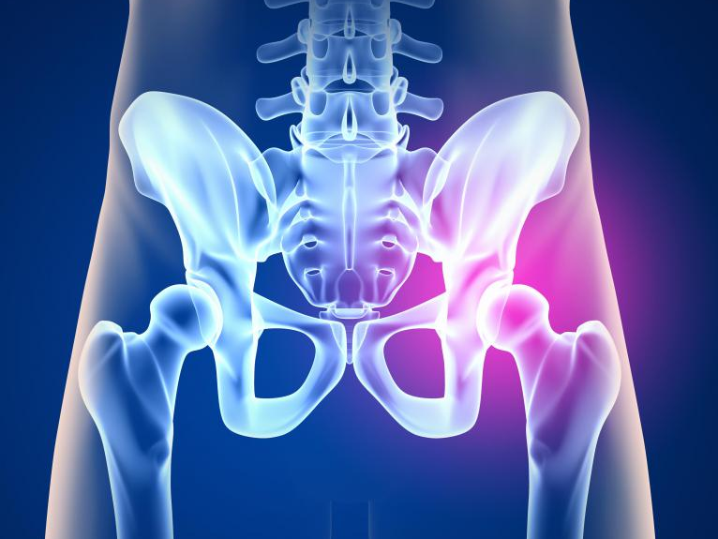
HIP ANATOMY
PT7001

Slide 2
Learning Outcomes
By the end of the lecture students should be able to:
Know
Know the principal bony features in and around the hip joint, and describe their appearance in plain X-rays
State
State the shape of the articular surfaces and describe the attachments of the capsule and synovium
Describe
Describe the capsular and intra-capsular ligaments of the joint and know how they limit joint movement
Describe
Describe the functions of the muscles surrounding the hip joint in terms of their attachment, actions, nerve supply and their role in stability
Describe
Describe the blood and nerve supply to the joint, and appreciate the significance of this supply in relation to hip fractures

Slide 3
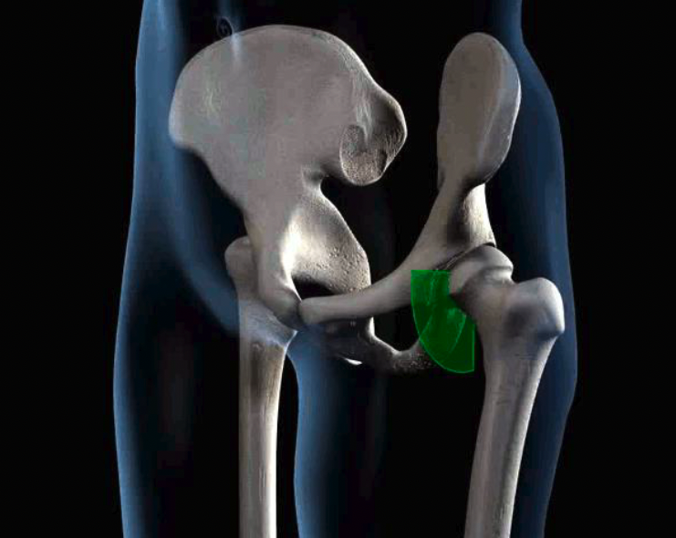
NEUTRAL
0°

Slide 4
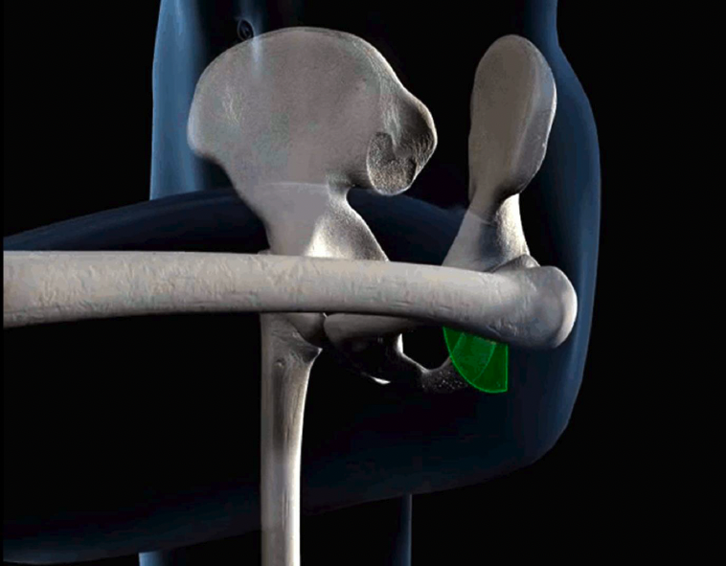

FLEXION
$\sim$100°

Slide 5
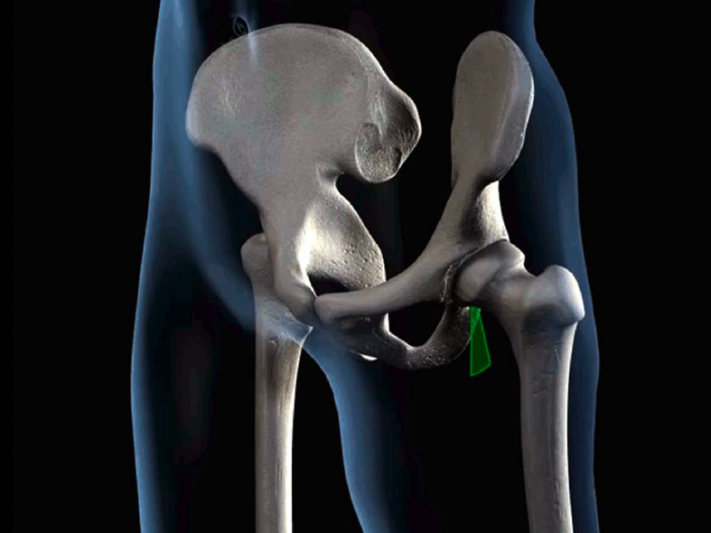

EXTENSION
$\sim 3$0°

Slide 6
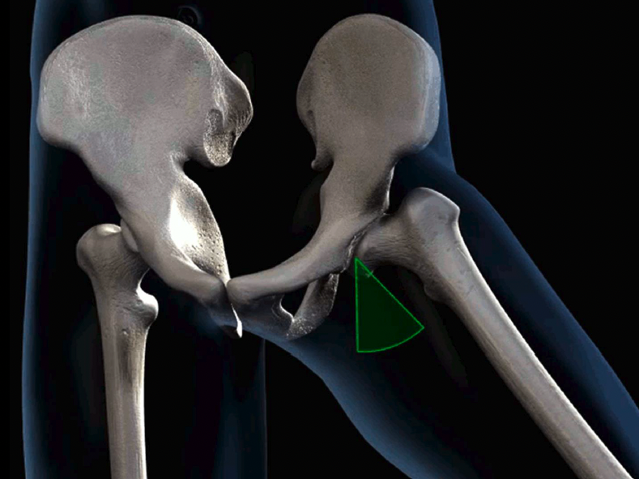

ABDUCTION
$\sim 4$0°

Slide 7
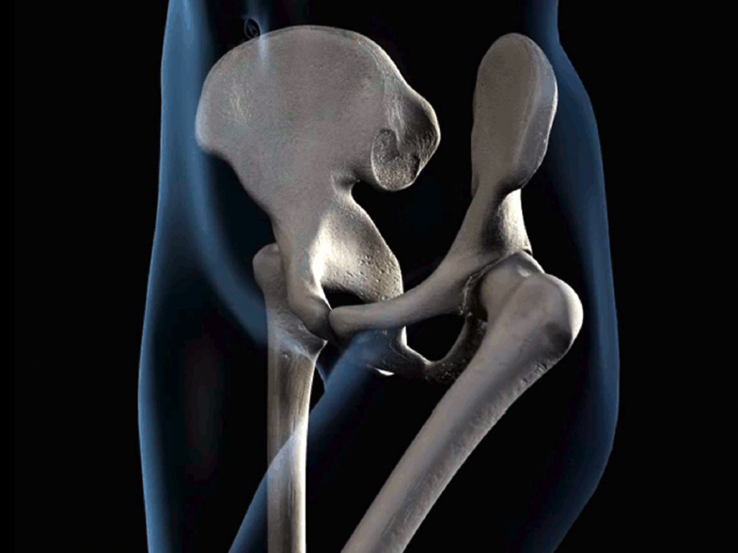

MEDIAL ROTATION
$\sim 4$0°

Slide 8
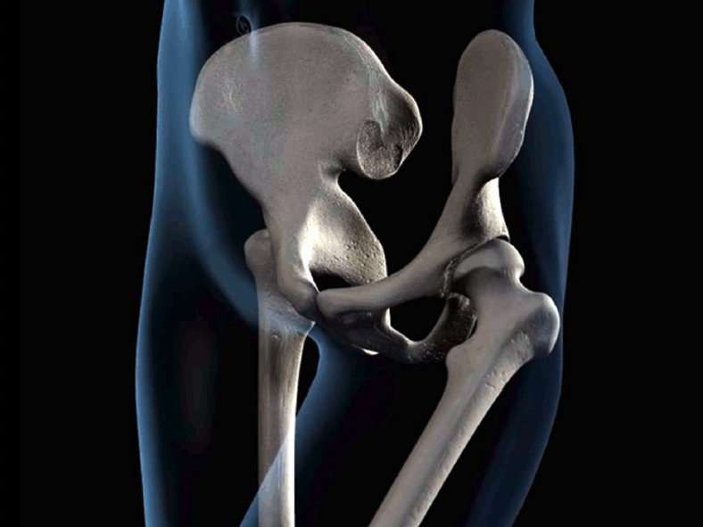

LATERAL ROTATION
$\sim 5$0°

Slide 9
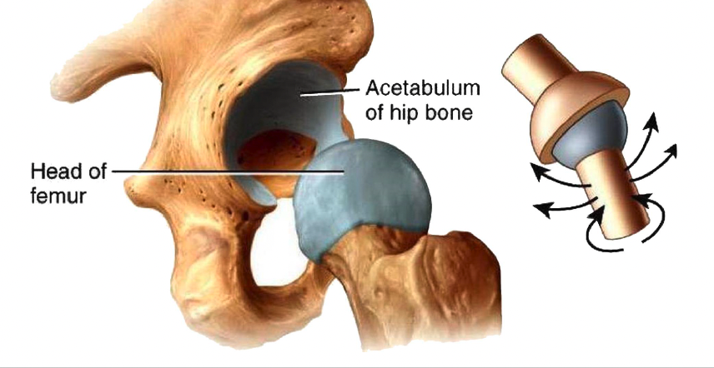
ACETABULOFEMORAL JOINT
Know
Know the principal bony features in and around the hip joint, and describe their appearance in plain X-rays
Classification = A Synovial Ball and Socket joint
Movements available = Flexion, Extension, Adduction, Abduction, Medial & Lateral rotation
Planes of movement = Sagittal Frontal Transverse
Multi-axial = Medial-Lateral Anterior-Posterior Superior-Inferior
DEEP - gives STABILITY but compromises on MOBILITY

Slide 10
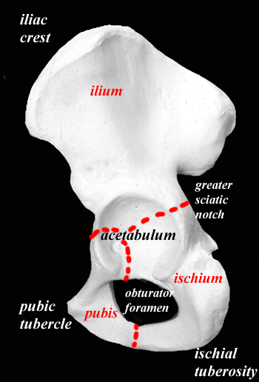
ACETABULOFEMORAL JOINT
Know
Know the principal bony features in and around the hip joint, and describe their appearance in plain X-rays
• Acetabulum
  - Ilium
  - Ischium
  - Pubis
• Femur
  Fuse to form the innominate bone

Slide 11
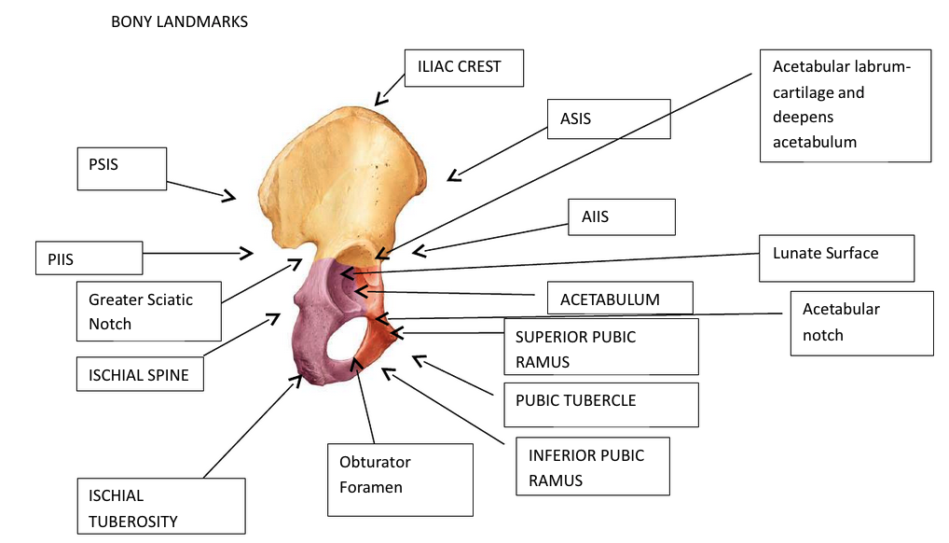
Know
Know the principal bony features in and around the hip joint, and describe their appearance in plain X-rays

Slide 12
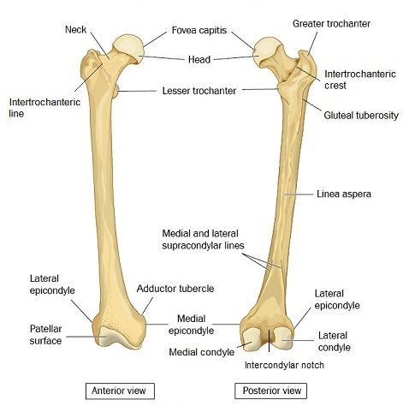
Know
Know the principal bony features in and around the hip joint, and describe their appearance in plain X-rays
The Femur
Head
Neck
Greater trochanter
Lesser trochanter
Shaft
Linea aspera
Trochanter = Greek ‘to run’
- running muscles attach

Slide 13
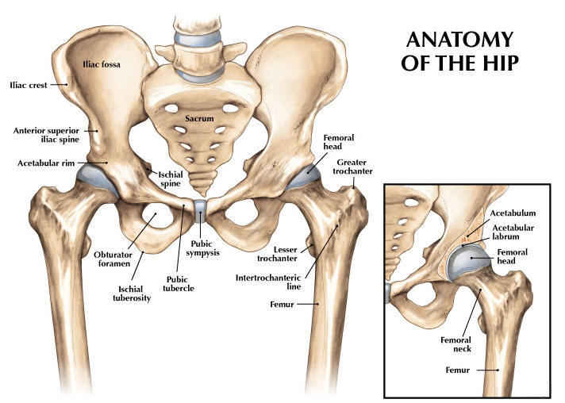
Know
Know the principal bony features in and around the hip joint, and describe their appearance in plain X-rays

Slide 14
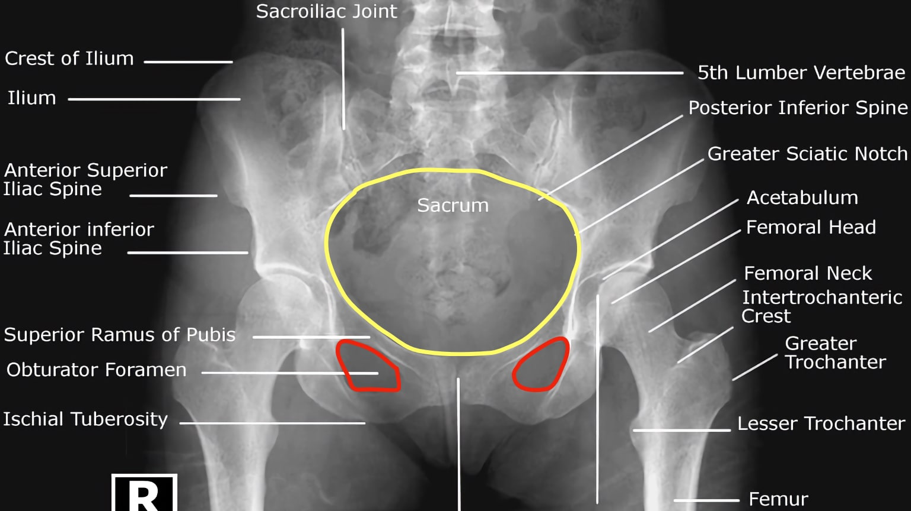
Know
Know the principal bony features in and around the hip joint, and describe their appearance in plain X-rays
Notes:
Pelvic ring

Slide 15
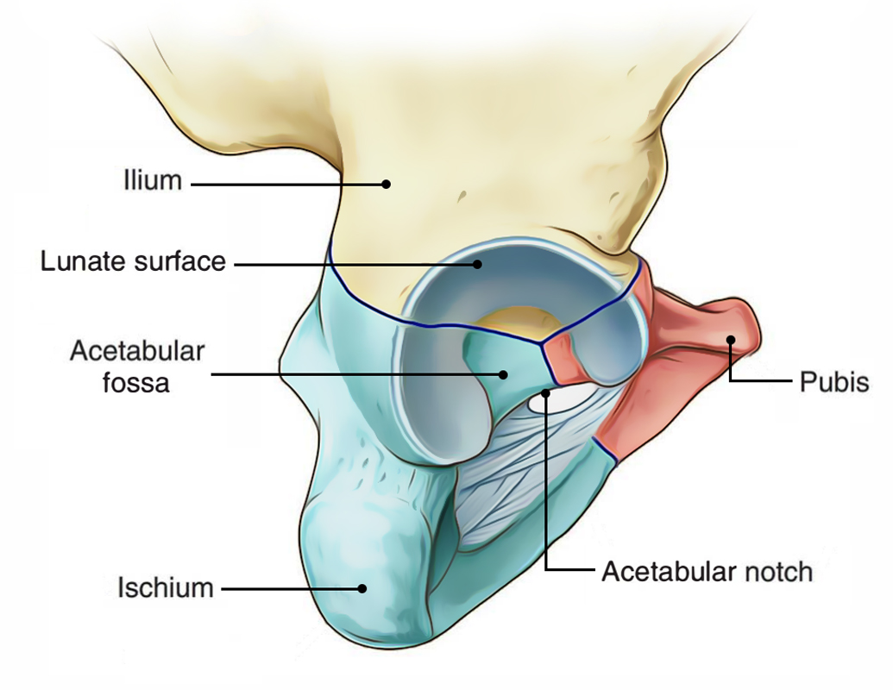
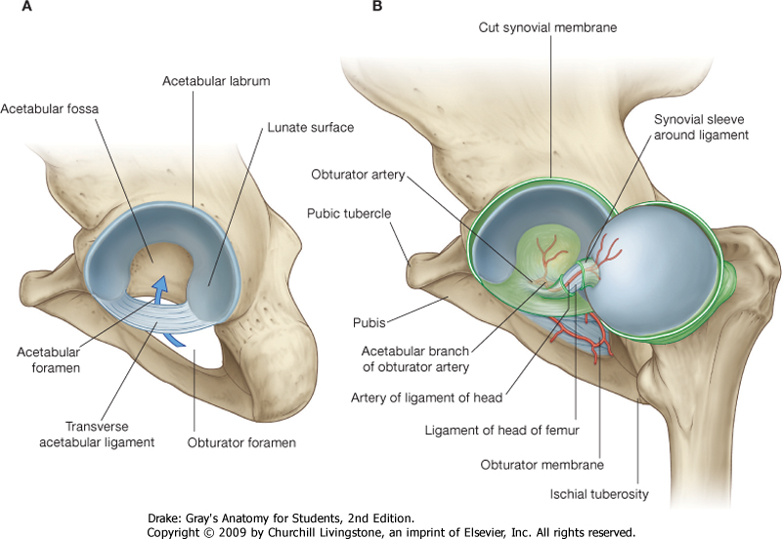
SURFACES
State
State the shape of the articular surfaces and describe the attachments of the capsule and synovium
lūna - moon, lūnātus - crescent-shaped
Prominent lunate surface of acetabulum covered by articular cartilage
Acetabular fossa (non-articular) contains fat, nerves, blood vessels
Acetabular foramen (gap) allows nerve & artery to the joint - bridged by transverse acetabular ligament

Slide 16
SURFACES
State
State the shape of the articular surfaces and describe the attachments of the capsule and synovium
• Femoral head articulates with the lunate
surface
- covered with articular cartilage
- except for the fovea capitus →
L. of head of femur attachment
(ligamentum teres)
Cartilage coefficient of friction ≈ 0.002 - 0.01
(ice ≈ 0.2- 0.5)

Slide 17
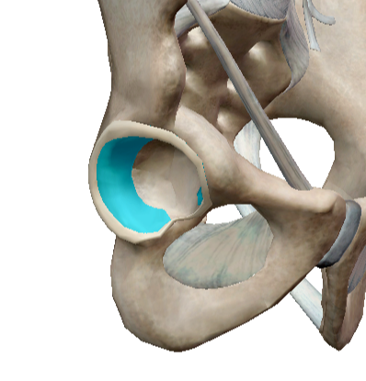
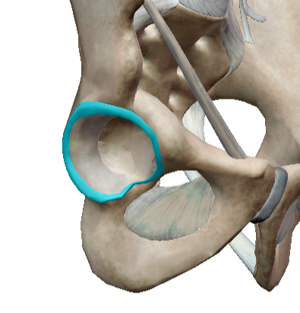
ACETABULAR HYALINE CARTILAGE
State
State the shape of the articular surfaces and describe the attachments of the capsule and synovium
Acetabular LABRUM
Acetabulum is deepened all round by the fibrocartilaginous acetabular labrum attached to the bony rim and to the transverse ligament.
    2/3 of femoral head in contact with the acetabulum
    Fibrocartilaginous lip to deepen socket
• vital for joint stability
• rupture can lead to dislocation
• likewise, disloc can cause rupture

Slide 18
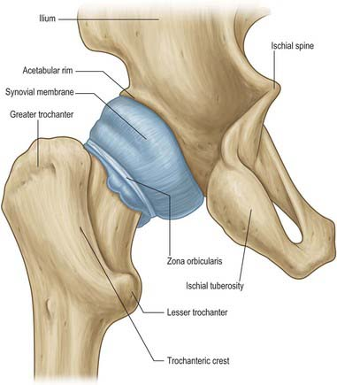
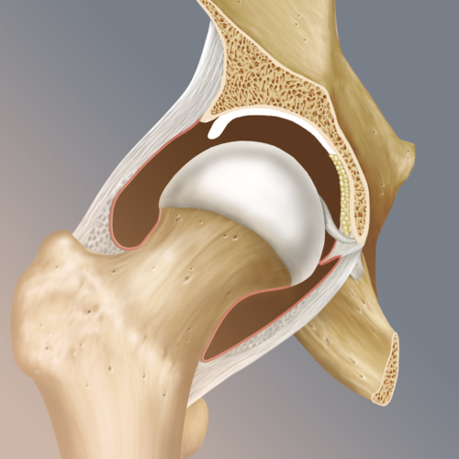
Capsule
State
State the shape of the articular surfaces and describe the attachments of the capsule and synovium
Synovial capsule
• Very strong fibrous capsule
- surrounds the head and neck of femur and
acetabulum to increase stability of joint, but
flexible enough to allow great RoM
Attaches:
- proximally to the acetabulum & transverse
acetabular ligament
- distally to the neck of the femur anteriorly
at the GT
• Synovial membrane (synovium)
- lines the inner surface of the fibrous capsule
and covers the acetabular labrum
- secretes synovial fluid

Slide 19
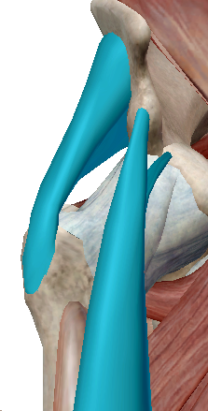
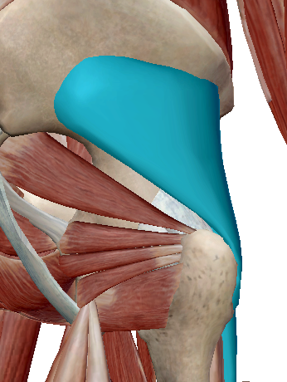
Stability
State
State the shape of the articular surfaces and describe the attachments of the capsule and synovium
  Anteromedially the capsule is strengthened by the deep fibres of the reflected head of rectus femoris
  Laterally the capsule is strengthened by deep fibres from gluteus minimus

Slide 20
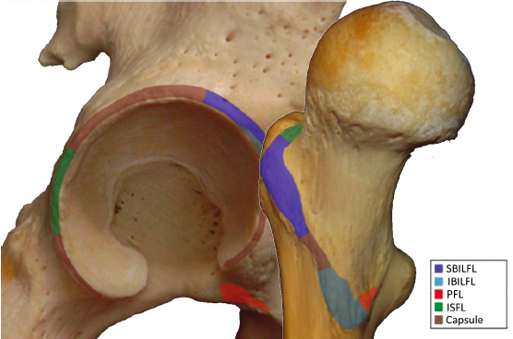
Capsule attachments
State
State the shape of the articular surfaces and describe the attachments of the capsule and synovium
Notes:
Superior and inferior bands

Slide 21
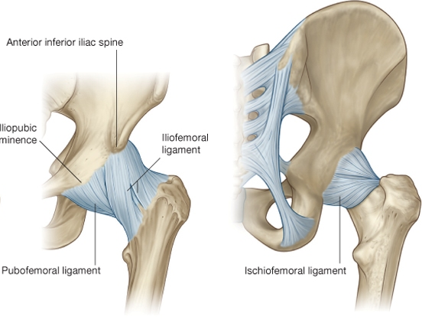
Capsular ligaments
Describe
Describe the capsular and intra-capsular ligaments of the joint and know how they limit joint movement
• iliofemoral ligament
very strong and thick
triangular band
• pubofemoral ligament
strengthens the inferior and
anterior aspects of the joint
capsule
• ischiofemoral ligament
spiral in shape
less well defined

Slide 22
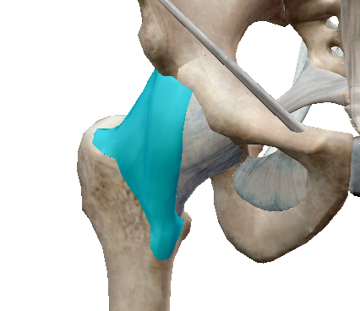
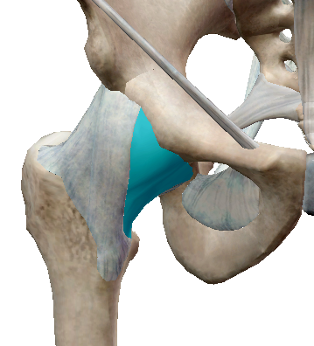
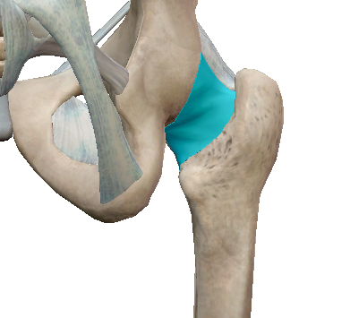
iliofemoral ligament
Describe
Describe the capsular and intra-capsular ligaments of the joint and know how they limit joint movement
Anteriorly situated
Originates at the AIIS and then fans out to insert along the intertrochanteric line of the femur.
Resists hip extension, adduction (superior fibres), and abduction (inferior fibres).
Anteriorly situated.
Originates from the anterior aspect of the pubic ramus and the iliopubic eminence and inserts on the anterior surface of the intertrochanteric fossa.
Resists hip abduction and extension.
pubofemoral ligament
Posteriorly situated.
Originates on the posterior surface of the acetabular rim and is said to "wind" around the joint and insert on the superior, anterior aspect of the greater trochanter.
Resists hip extension and medial rotation.
ischiofemoral ligament

Slide 23
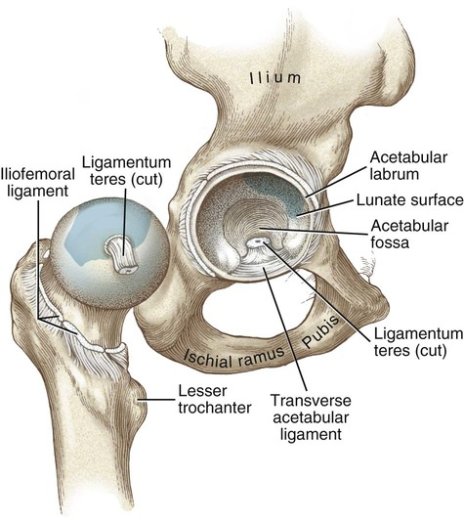
Intra-Capsular ligaments
Describe
Describe the capsular and intra-capsular ligaments of the joint and know how they limit joint movement
• Transverse acetabular ligament
- crosses the acetabular notch
• Ligament of head of femur
(ligamentum teres)
- attach to fovea
- no role in stability
- its synovial membrane forms a
tube for blood vessels
- sometimes absent in adults

Slide 24
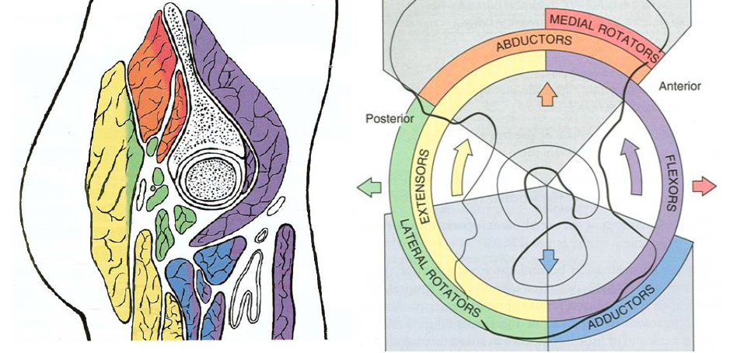
HIP muscles
Describe
Describe the functions of the muscles surrounding the hip joint in terms of their attachment, actions, nerve supply and their role in stability

Slide 25
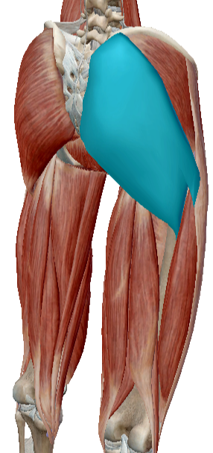
GLUTEAL MUSCLES
Describe
Describe the functions of the muscles surrounding the hip joint in terms of their attachment, actions, nerve supply and their role in stability
Gluteus Maximus
  Large, powerful extensor
  F - Extends & laterally rotates the thigh
  O - Posterior gluteal line of the ilium, iliac crest,
  aponeurosis of the erector spinae, dorsal
  surface of the lower part of the sacrum, side
  of the coccyx, sacrotuberous ligament and
  intermuscular fascia
  I - Iliotibial tract of the fascia lata and the gluteal
  tuberosity of the femur
  i - Inferior gluteal nerve. L5-S2

Slide 26
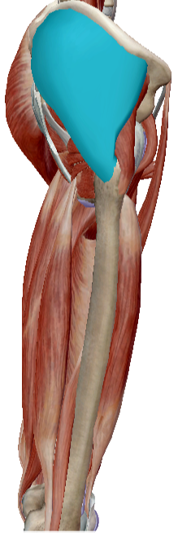
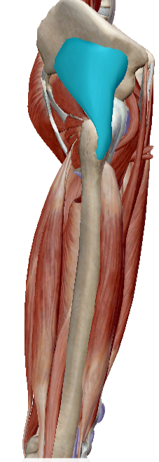
GLUTEAL MUSCLES
Describe
Describe the functions of the muscles surrounding the hip joint in terms of their attachment, actions, nerve supply and their role in stability
Gluteus Medius
  F - Abducts and medially rotates the thigh. Anterior portion
  flexes the thigh & the posterior portion extends thigh
  O - Outer surface of the ilium between the iliac crest of the
  posterior gluteal line, anterior gluteal line
  I - The lateral surface of the greater trochanter
  i - Superior gluteal nerve. L4-S1
  Gluteus Minimus
  F - Abducts & medially rotates the thigh
  O - Outer surface of the ilium between the anterior &
  inferior gluteal lines and the margin of the greater
  sciatic notch
  I - The ridge laterally situated on the anterior surface of the
  greater trochanter
  i - Superior gluteal nerve. L4-S1

Slide 27
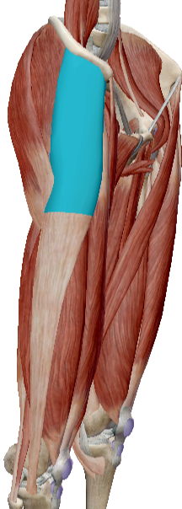
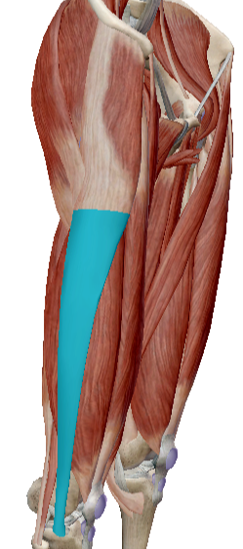
Tensor Fascia Lata/
Iliotibial Band
Describe
Describe the functions of the muscles surrounding the hip joint in terms of their attachment, actions, nerve supply and their role in stability
TFL
  F - Hip flexion, abduction, MR
  O - Iliac crest & lateral surface of ASIS
  I - into tendinous iliotibial tract (band)
  i - Superior gluteal nerve. L4-S1
  ITB
  • Strong membranous fascia,
  • Continuous of TFL
  • Attaches to the lateral condyle of the tibia

Slide 28
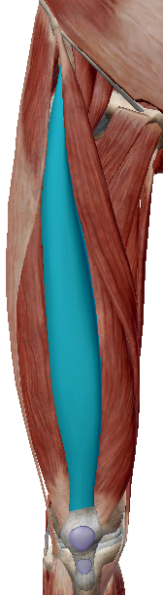
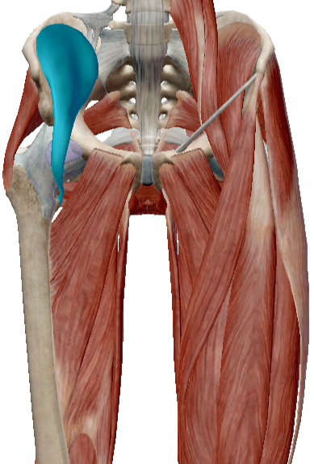
Hip flexors
Describe
Describe the functions of the muscles surrounding the hip joint in terms of their attachment, actions, nerve supply and their role in stability
Rectus Femoris
• of quadriceps group
  F - Flexes the hip joint & extends the knee joint
  O - by two heads, from the anterior inferior iliac
  spine and a reflected head from a groove above
  the acetabulum
  I - Base of the patella
  i - Femoral nerve. L2-L4
Iliacus
  O - Iliac fossa superior 2/3, and upper sacrum
  I - lesser trochanter via psoas major tendon
  F - flexes the thigh
  i – Femoral nerve L2-L3
  Psoas major and iliacus form conjoined tendon which inserts on to lesser trochanter = ILIOPSOAS

Slide 29
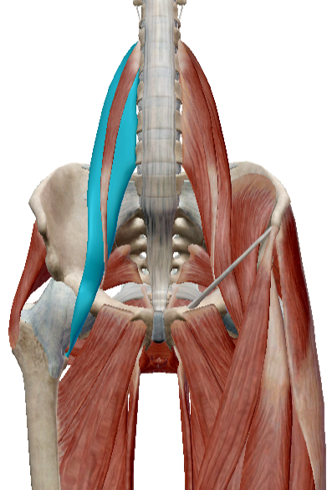
ILIOPSOAS GROUP
Describe
Describe the functions of the muscles surrounding the hip joint in terms of their attachment, actions, nerve supply and their role in stability
  Powerful hip flexors
  3 muscles with different O but common I
  - Iliacus
  - psoas minor
  - psoas major
  Psoas major
  O - transverse processes, bodies and
  intervertebral discs of lumbar (& body of
  12th thoracic)
  I - lesser trochanter of femur
  i – Lumbar plexus L2-L3

Slide 30
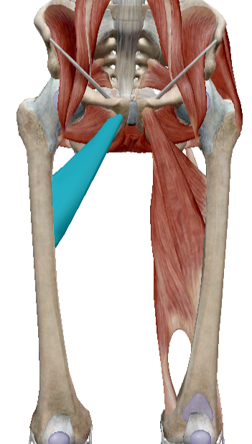
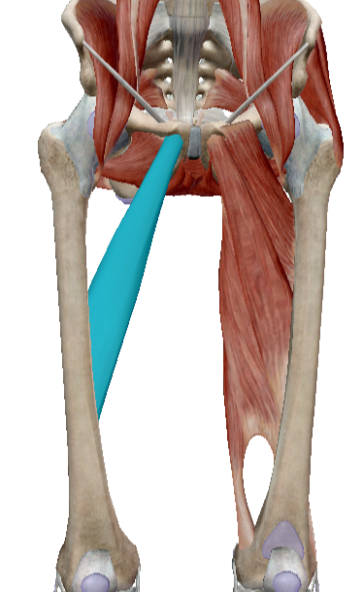
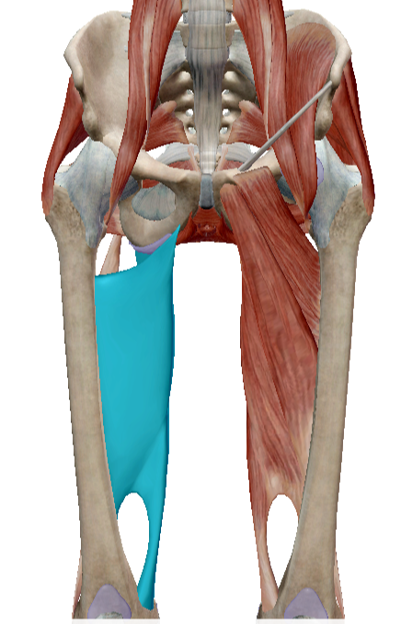
adductors
Adductor Brevis
  O - pubis
  I - medial portion of
  upper linea aspera
  i - obturator nerve. L2-L4
Adductor Magnus
  O – inferior ramus of pubis and ischium
  I - linea aspera and has tendon all the
  way to medial epicondyle
  i - obturator nerve. L2-L4 & Tibial
  portion of the sciatic nerve. L2-L4
Adductor Longus
  O – pubic crest & symphysis
  I - medial portion of linea
  aspera (below brevis)
  i - obturator nerve. L2-L4

Slide 31
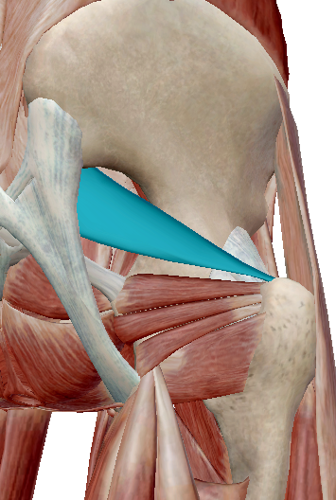
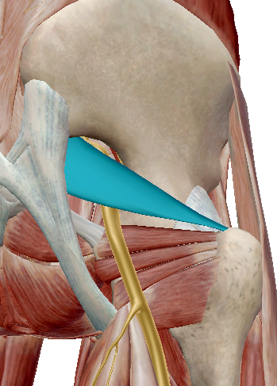
piriformis
Describe
Describe the functions of the muscles surrounding the hip joint in terms of their attachment, actions, nerve supply and their role in stability
  F - Laterally rotates & abducts the thigh,
  also medially rotates thigh depending on
  hip position
  O - Anterior sacrum, gluteal surface of the
  ilium, capsule of the sacroiliac joint &
  sacrotuberous ligament
  I - Upper border of the greater trochanter
  of the femur
  i - Sacral plexus. S1
Sciatic nerve
L4-S3
10% of population sciatic nerve runs through the piriformis rather than under

Slide 32
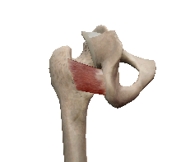
Quadratus femoris
Describe
Describe the functions of the muscles surrounding the hip joint in terms of their attachment, actions, nerve supply and their role in stability
  F - Laterally rotates and adducts the hip joint.
  O - Superior lateral margin of the ischial
  tuberosity.
  I - Quadrate tubercle of the intertrochenteric
  crest and the bone immediately inferior.
  i - Sacral plexus. L5–S2.

Slide 33
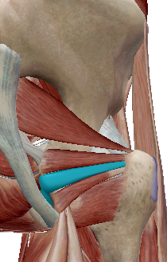
Obturator internus
Describe
Describe the functions of the muscles surrounding the hip joint in terms of their attachment, actions, nerve supply and their role in stability
  F - Laterally rotates the hip joint. Abducts
  when thigh is flexed
  O - Internal surface of the anterolateral wall
  of the pelvis & the obturator membrane
  I - Medial surface of the greater trochanter
  of the femur
  i - Nerve to obturator internus. L5–S2.

Slide 34
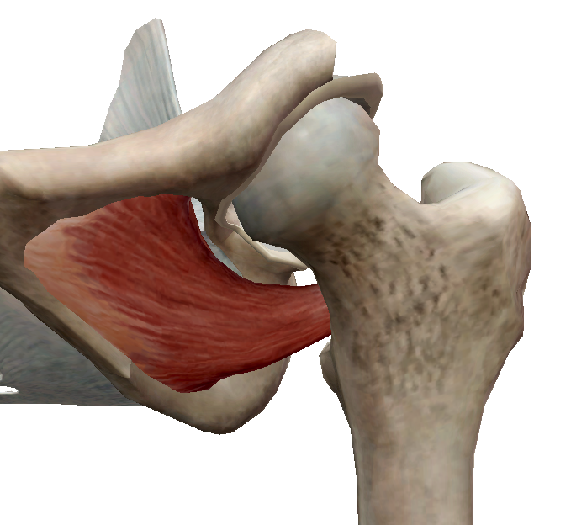
Obturator externus
Describe
Describe the functions of the muscles surrounding the hip joint in terms of their attachment, actions, nerve supply and their role in stability
  F - Laterally rotates the thigh
  O - Rami of pubis, ramus of the ischium &
  medial 2/3rdof the outer surface of the
  obturator membrane
  I - Trochanteric fossa of the femur
  Ii - Obturator nerve. L3-L4.

Slide 35
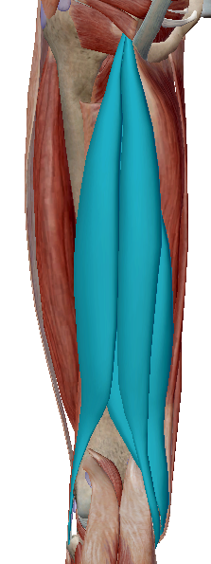
hamstrings
Describe
Describe the functions of the muscles surrounding the hip joint in terms of their attachment, actions, nerve supply and their role in stability
  Common origin = Ischial tuberosity (except short head Biceps Femoris)
  Biceps Femoris
  • 2 heads different origins
  - Long head origin = Ischial tuberosity
  - Short head origin = Linea Aspera
  • Common insertion (lateral side of head of Fibula and
  lateral Tibial condyle)
  • Both flex knee, long head also hip extension
  Semimembranosus, Semitendinosus
  Insertions = shaft of tibia, medial tibial condyle
  Knee flexion, hip extension & slight medial rotation
  i - Tibial portion of the sciatic nerve. L5-S2
BF
ST
SM

Slide 36
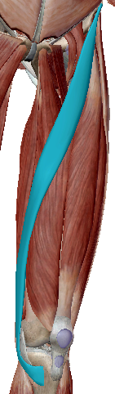
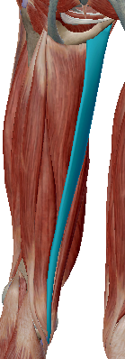
Bi-articular muscles of the hip
Describe
Describe the functions of the muscles surrounding the hip joint in terms of their attachment, actions, nerve supply and their role in stability
Rectus femoris
As before
Sartorius
F - Flexes, abducts & laterally rotates the hip joint,
also rotates the tibia medially
O - ASIS and notch below
I - superior medial surface of tibia, anterior to gracilis
i - femoral nerve L2-L3
Gracilis
F - Adducts the hip joint, flexes the knee & rotates the
tibia medially
O - Thin aponeurosis from the medial margins of the
lower half of the body of the pubis & the whole of the
inferior ramus
I - Proximal part of the medial surface of the tibia, below
the tibial condyle & just proximal to the tendon of
semitendinosus
i - Obturator nerve. L2-L3

Slide 37
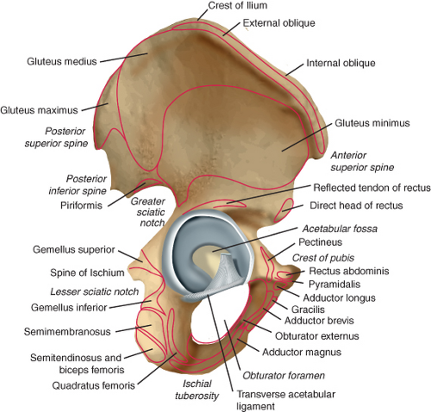
Muscle attachment sites at the hip
Describe
Describe the functions of the muscles surrounding the hip joint in terms of their attachment, actions, nerve supply and their role in stability

Slide 38
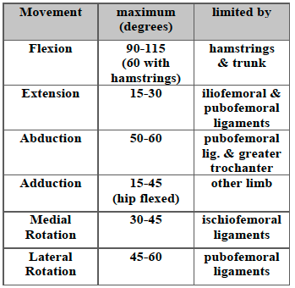
Limitations of movements

Slide 39
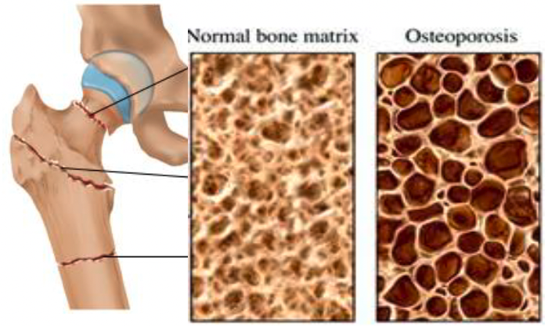
hip fractures
Describe
Describe the blood and nerve supply to the joint, and appreciate the significance of this supply in relation to hip fractures
TRANSCERVICAL →
(intracapsular)
INTERTROCHANTERIC →
(extracapsular)
SUBTROCHANTERIC →
(extracapsular)

Slide 40

blood supply to the femoral head
Describe
Describe the blood and nerve supply to the joint, and appreciate the significance of this supply in relation to hip fractures
A major complication of displacement of the femoral head through either fracture or dislocation is avascular necrosis - if blood supply is denied, the head will die within 6 hours and will not repair itself.
PROFUNDA FEMORIS
(LATERAL & MEDIAL CIRCUMFLEX FEMORAL ARTERIES)
→ Branches to RETINACULAR ARTERIES

Slide 41

blood supply to the femoral head
Describe
Describe the blood and nerve supply to the joint, and appreciate the significance of this supply in relation to hip fractures
The blood supply to the femoral head is complex and involves several arteries with blood being delivered from distal to proximal.
KEY VESSELS.
If there is a fracture at the femoral head, these vessels may be at risk of rupture
- if intertrochanteric, they will be ok
- if # is through the neck or just
below the head, the retinacular
arteries are at risk
- if rupture or clotting occurs →
avascular necrosis

Slide 42

Avascular necrosis of femoral head
Describe
Describe the blood and nerve supply to the joint, and appreciate the significance of this supply in relation to hip fractures

Slide 43

Function of the q-angle
  The Q angle represents the relationship and alignment between the pelvis, leg and foot
  Line of force of the quadriceps muscle
  Important in athletes since repetitive stress on structures causes injury and pain
  Angle 13° - 20° ‘normal’. Wide discrepancies!
  Males lower end, females higher end
  Abnormally high Q angle can promote injuries at knee, hip, foot, and lower back

